Slide 1

An Introduction to Scrum
Part II

Slide 2
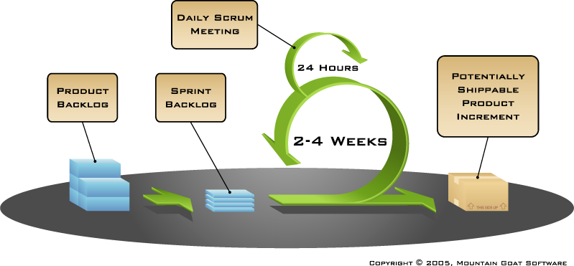
Putting it all together

Slide 3

Scrum framework
Roles
Product owner
ScrumMaster
Team
Ceremonies
Sprint planning
Sprint review
Sprint retrospective
Daily scrum meeting
Artifacts
Product backlog
Sprint backlog
Burndown charts

Slide 4
Scrum framework
Roles
Product owner
Scrum Master
Team
Ceremonies
Sprint planning
Sprint review
Sprint retrospective
Daily scrum meeting
Artifacts
Product backlog
Sprint backlog
Burndown charts

Slide 5

Product owner
Define the features of the product
Decide on release date and content
Be responsible for the profitability of the product (ROI)
Prioritize features according to market value
Adjust features and priority every iteration, as needed
Accept or reject work results
Notes:
Everyone know what ROI means?

Slide 6

The ScrumMaster
Represents management to the project
Responsible for enacting Scrum values and practices
Remove impediments
Ensure that the team is fully functional and productive
Enable close cooperation across all roles and functions
Shield the team from external interferences

Slide 7





The team
Typically 5-9 people
Cross-functional:
Programmers, testers, user experience designers, etc.
Members should be full-time
May be exceptions (e.g., database administrator)

Slide 8
The team
Teams are self-organizing
Ideally, no titles but rarely a possibility
Membership should change only between sprints

Slide 9
Scrum framework
Roles
Product owner
ScrumMaster
Team
Ceremonies
Sprint planning
Sprint review
Sprint retrospective
Daily scrum meeting
Artifacts
Product backlog
Sprint backlog
Burndown charts

Slide 10



Team capacity
Sprint planning meeting
Sprint prioritization
Product backlog
Sprint
goal
Analyze and evaluate product backlog
Select sprint goal
Business conditions
Sprint planning
Decide how to achieve sprint goal (design)
Create sprint backlog (tasks) from product backlog items (user stories / features)
Estimate sprint backlog in hours
Current product
Sprint
backlog
Technology
Notes:
More than 1 way of doing this.
Seen varying opinions on needing a “Sprint Goal”.

Slide 11

Sprint planning
Team selects items from the product backlog they can commit to completing
Sprint backlog is created
Tasks are identified and each is estimated (max 2 days)
Collaboratively, not done alone by the ScrumMaster (or anyone else)
High-level design is considered
As a vacation planner, I want to see photos of the hotels.
Code the middle tier (8 hours)
Code the user interface (4)
Write test fixtures (4)
Code the foo class (6)
Update performance tests (4)
Notes:
This is one way

Slide 12
Exercise – sprint Planning
Notes:
We’re going to cover one way of doing this. Groups of 5:
Writing user stories (group writing, read out each as you’re done) - 5 mins
Bunch them up into related stories, and areas of the system (product backlog) – 3 mins
Writing tasks (pick one story at random) – 5 mins
Planning poker – 8 mins

Slide 13
As a <>, I want to <> so that <>
Notes:
We’re going to cover one way of doing this. Groups of 5:
Writing user stories (group writing, read out each as you’re done) - 5 mins
Bunch them up into related stories, and areas of the system (product backlog) – 3 mins
Writing tasks (pick one story at random) – 5 mins
Planning poker – 8 mins

Slide 14
Exercise wrap up
Notes:
How was it?
What did the discussions reveal? Was discussion only about the number of hours, or did new information surface?

Slide 15
The daily scrum
Parameters
Daily
15-minutes
Stand-up
Not for problem solving
Whole world is invited
Only team members, ScrumMaster, product owner, can talk
Helps avoid other unnecessary meetings

Slide 16

Everyone answers 3 questions
1
What did you do yesterday?
2
What will you do today?
3
Is anything in your way?
These are not status updates for the ScrumMaster
They are commitments in front of peers
Notes:
Shouldn’t be speaking to SM or PO

Slide 17
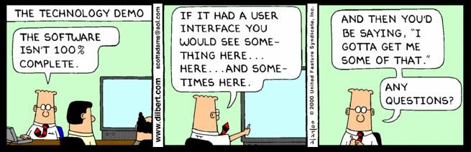
The sprint review

Slide 18
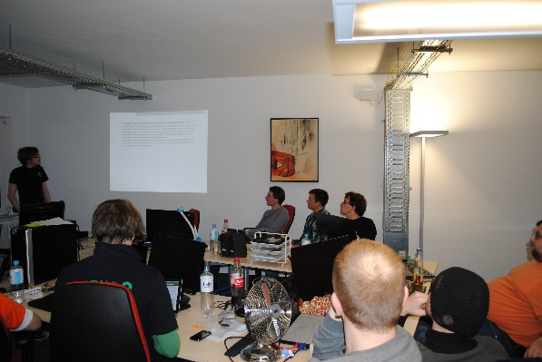
The sprint review
Team presents what it accomplished during the sprint
Typically takes the form of a demo of new features or underlying architecture
Informal
2-hour prep time rule
No slides
Whole team participates
Invite the world

Slide 19
Sprint retrospective
Periodically take a look at what is and is not working
Typically 15–30 minutes
Done after every sprint
Whole team participates
Scrum Master
Product owner
Team
Possibly customers and others
Notes:
In Mitch’s course, he suggested 2 hours.

Slide 20

Start / Stop / Continue
Whole team gathers and discusses what they’d like to:
Start doing
Stop doing
This is just one of many ways to do a sprint retrospective.
Continue doing

Slide 21
Scrum framework
Roles
Product owner
ScrumMaster
Team
Ceremonies
Sprint planning
Sprint review
Sprint retrospective
Daily scrum meeting
Artifacts
Product backlog
Sprint backlog
Burndown charts

Slide 22

Product backlog
The requirements
A list of all desired work on the project
Ideally expressed such that each item has value to the users or customers of the product
Prioritized by the product owner
Reprioritized at the start of each sprint
This is the product backlog

Slide 23
A sample product backlog
Backlog item | Estimate
Allow a guest to make a reservation | 3
As a guest, I want to cancel a reservation. | 5
As a guest, I want to change the dates of a reservation. | 3
As a hotel employee, I can run RevPAR reports (revenue-per-available-room) | 8
Improve exception handling | 8
... | 30
... | 50

Slide 24
The sprint goal
A short statement of what the work will be focused on during the sprint
Life Sciences
Support features necessary for population genetics studies.
Database Application
Make the application run on SQL Server in addition to Oracle.
Financial services
Support more technical indicators than company ABC with real-time, streaming data.

Slide 25
Managing the sprint backlog
Individuals sign up for work of their own choosing
Work is never assigned
Estimated work remaining is updated daily
Notes:
The most controversial 2 slides

Slide 26
Managing the sprint backlog
Any team member can add, delete or change the sprint backlog
Work for the sprint emerges
If work is unclear, define a sprint backlog item with a larger amount of time and break it down later
Update work remaining as more becomes known

Slide 27
A sprint backlog
Tasks
Mon
Tues
Wed
Thur
Fri
Code the user interface
8
4
8
Code the middle tier
16
12
10
4
Test the middle tier
8
16
16
11
8
Write online help
12
Write the foo class
8
8
8
8
8
Add error logging
8
4

Slide 28

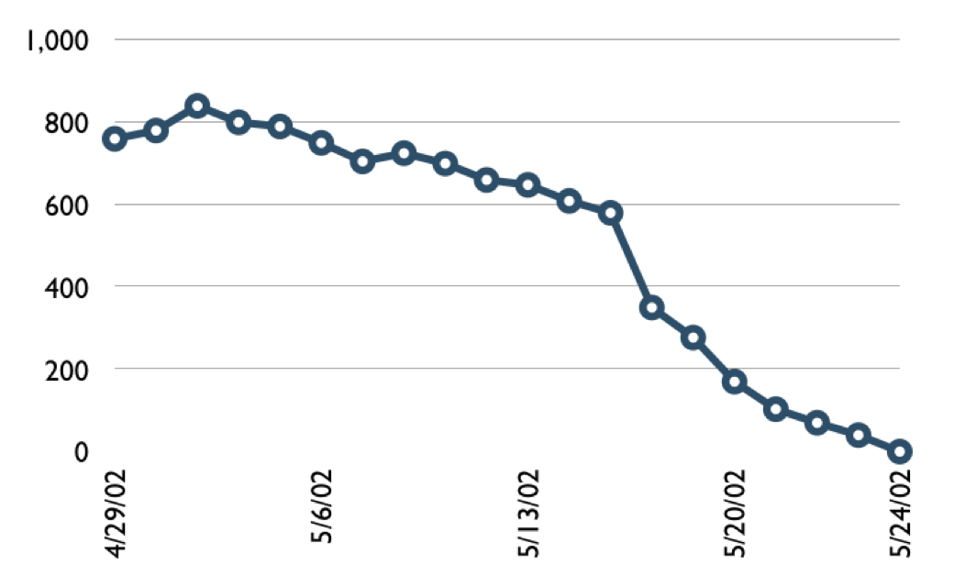
A sprint burndown chart
Hours
Notes:
Different ways of managing these.
Often based on “effort remaining”

Slide 29
Tasks
Mon
Tues
Wed
Thur
Fri
Code the user interface
8
4
8
Code the middle tier
16
12
10
7
Test the middle tier
8
16
16
11
8
Write online help
12
50
40
30
Hours
20
10
0
Mon
Tue
Wed
Thu
Fri

Slide 30
Summarising the sprint

Slide 31
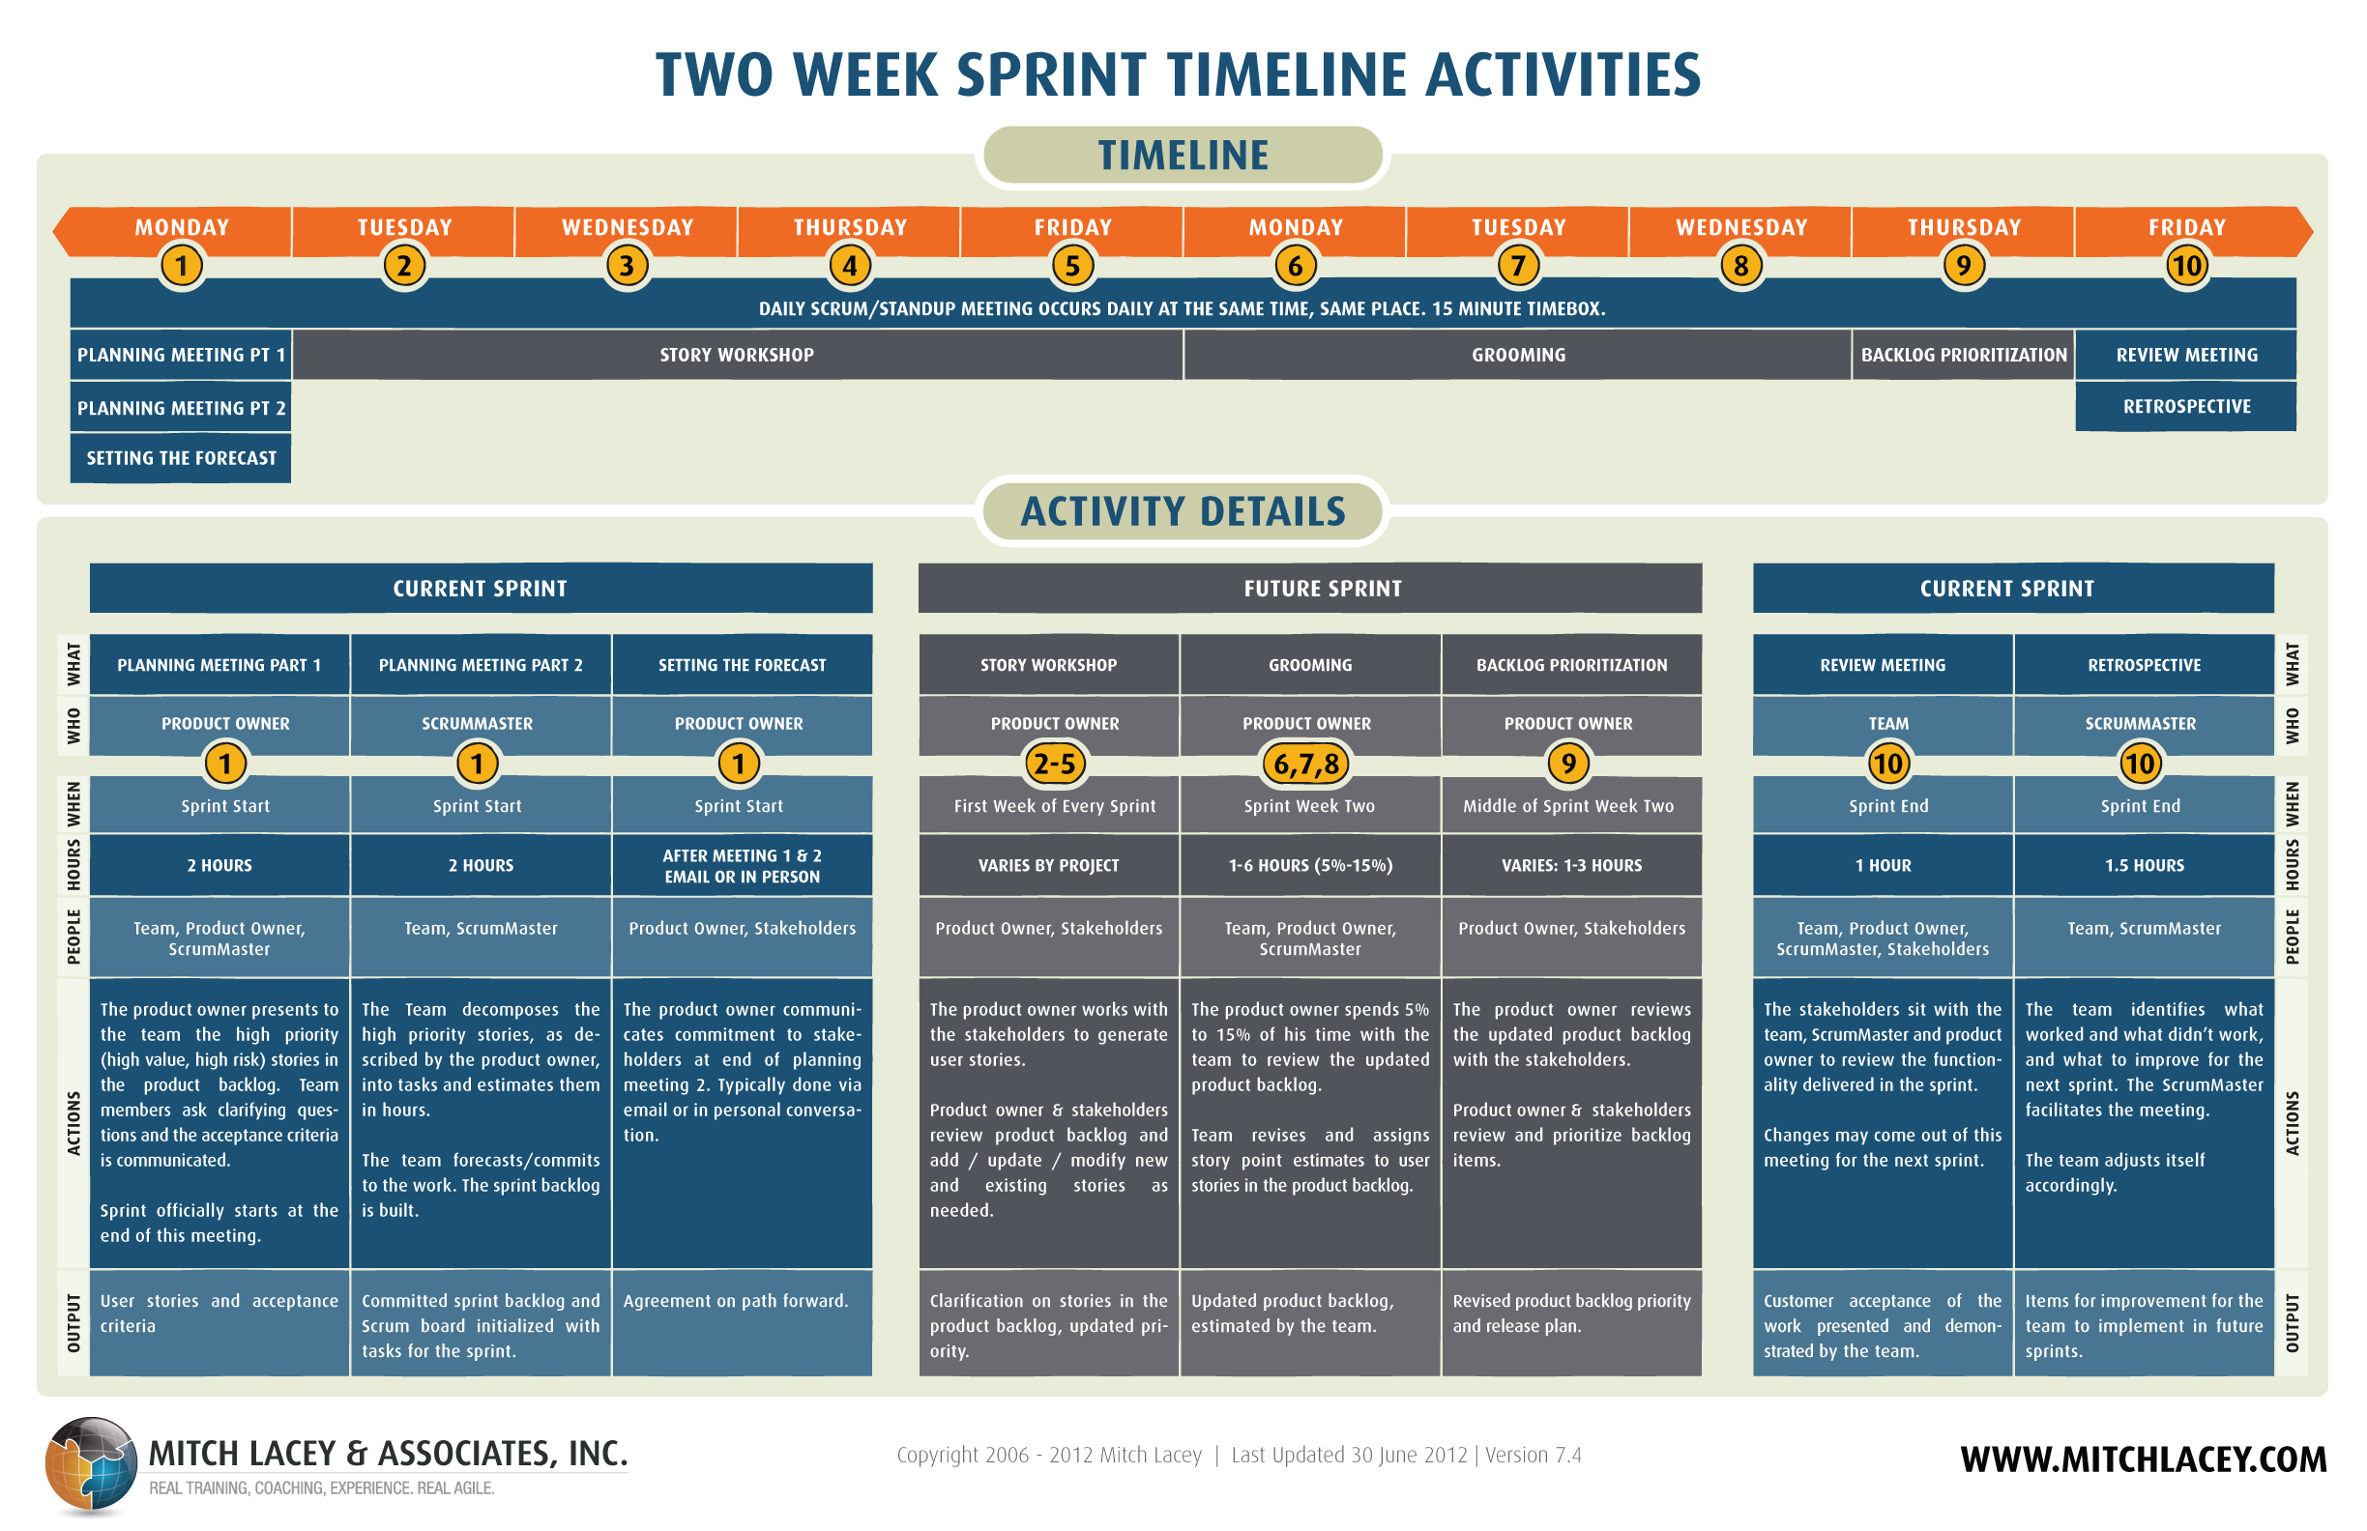

Slide 33
Scalability
Typical individual team is 7 ± 2 people
Scalability comes from teams of teams
Factors in scaling
Type of application
Team size
Team dispersion
Project duration
Scrum has been used on multiple 500+ person projects

Slide 34






Scaling through the Scrum of scrums

Slide 35
Scrum of scrums of scrums
Notes:
I guess you can also have a scrum of scrums of scrums of scrums etc

Slide 36
Where to go next
P:\Learning\Scrum
www.scrumalliance.org
www.scrum.org
www.scrumguides.org
www.mountaingoatsoftware.com/scrum
Thursday Scrum Lunch sessions

Slide 37
A Scrum reading list
Agile and Iterative Development: A Manager’s Guide by Craig Larman
Agile Estimating and Planning by Mike Cohn
Agile Project Management with Scrum by Ken Schwaber
Agile Retrospectives by Esther Derby and Diana Larsen

Slide 38
A Scrum reading list
Agile Software Development Ecosystems by Jim Highsmith
Agile Software Development with Scrum by Ken Schwaber and Mike Beedle
Scrum and The Enterprise by Ken Schwaber
Succeeding with Agile by Mike Cohn
User Stories Applied for Agile Software Development by Mike Cohn

